Slide 1


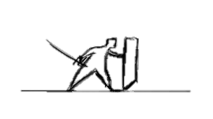


Technology Team
Technology Hotel Management
Lazuardi Arsy
Heri Agus Susanto
Atika Prima Nugraheni
Cepat
Mudah
Akurat

Slide 2

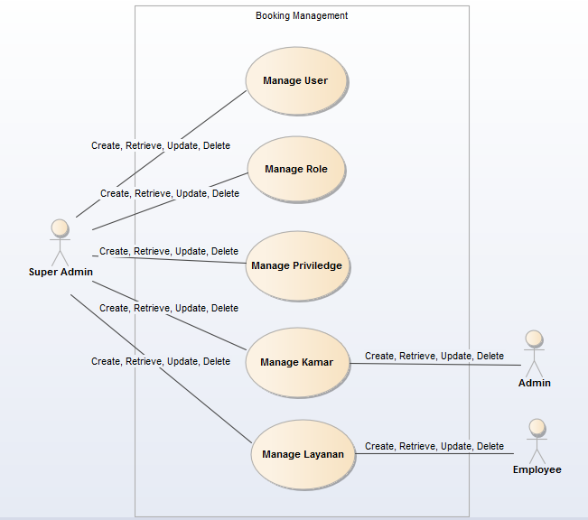


1
Use case
diagram
Booking Management

Slide 3
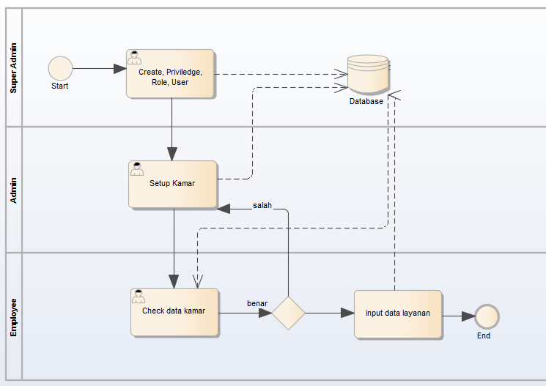
Business Prosess
2
Booking Management

Slide 4
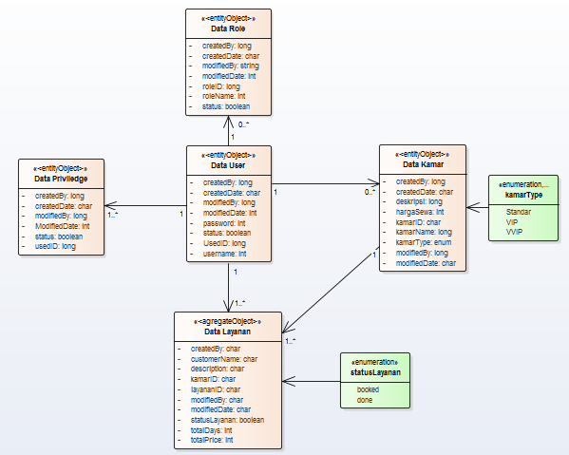
Class diagram
3
Booking Management

Slide 5
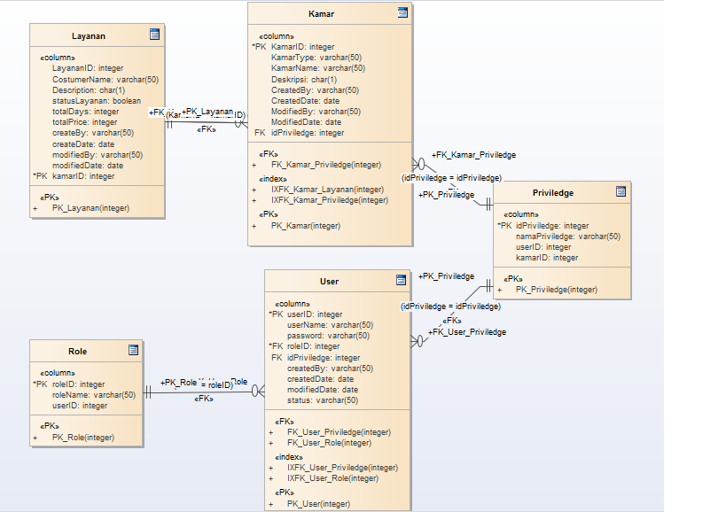
ER Diagram
4
Booking Management

Slide 6
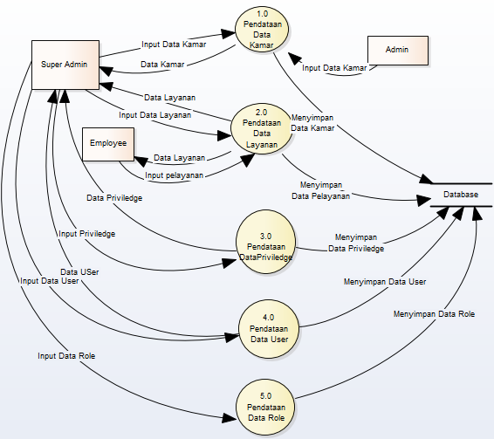
DFD
6
Booking Management

Slide 7
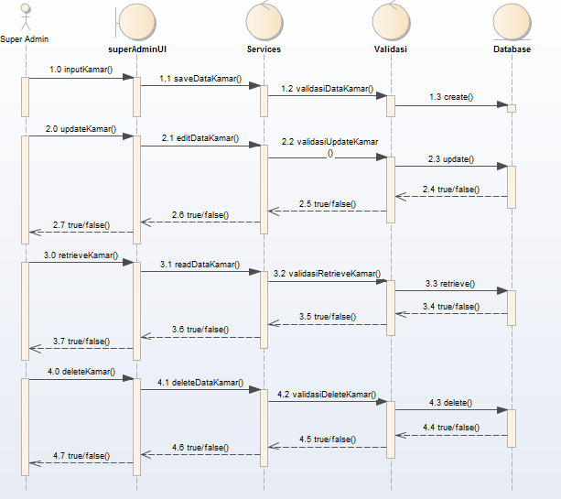
Sequence Diagram
7
Super Admin
Booking Management

Slide 8
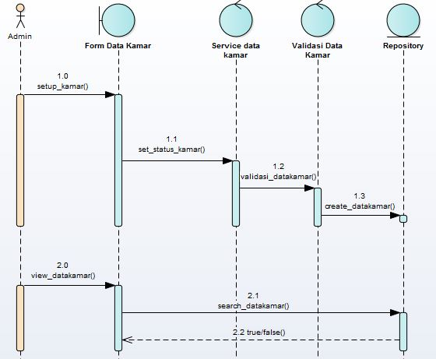
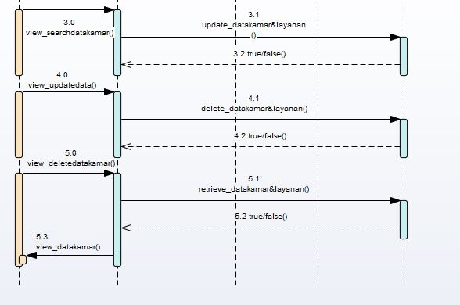
Sequence Diagram
8
Admin
Booking Management

Slide 9
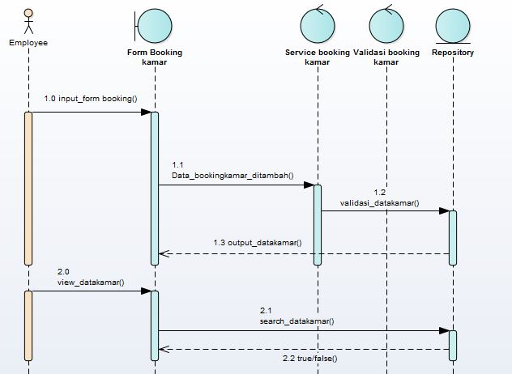
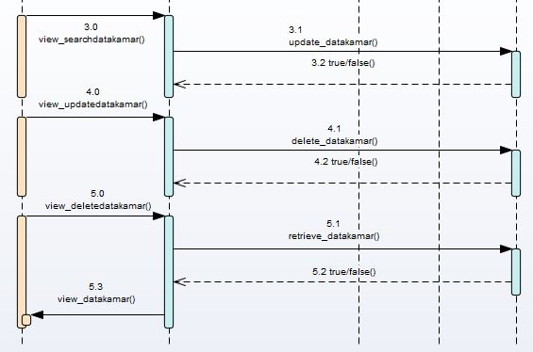
Sequence Diagram
9
Employee
Booking Management

Slide 10
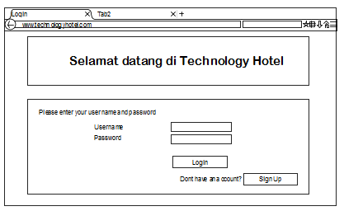
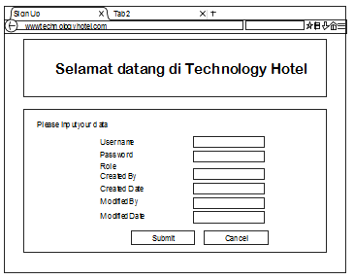
User Interface
10
Login
Booking Management

Slide 11
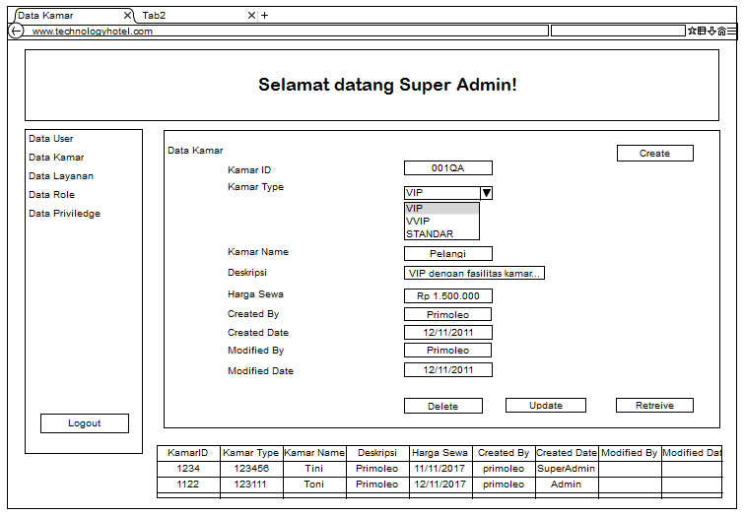
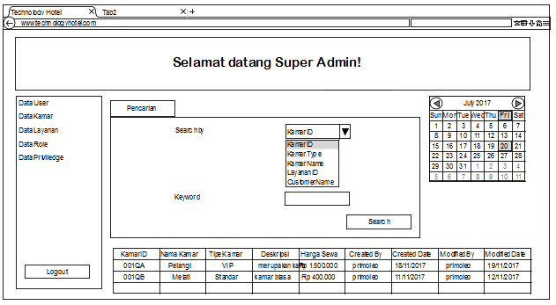
User Interface
11
Dashboard super admin
Data Kamar
Booking Management

Slide 12
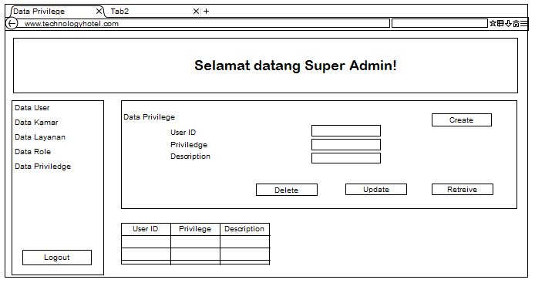
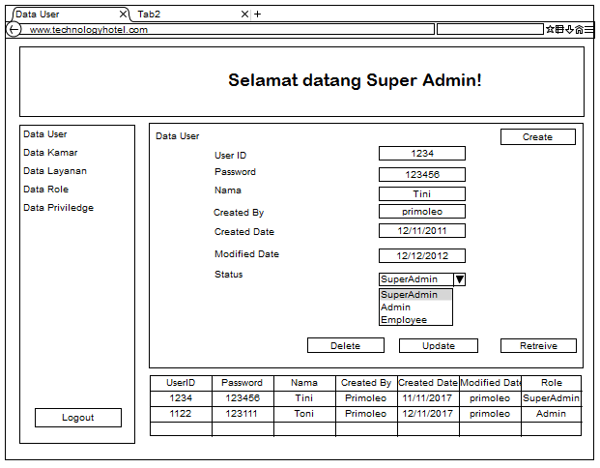
User Interface
12
Data privilege
Data user
Booking Management

Slide 13
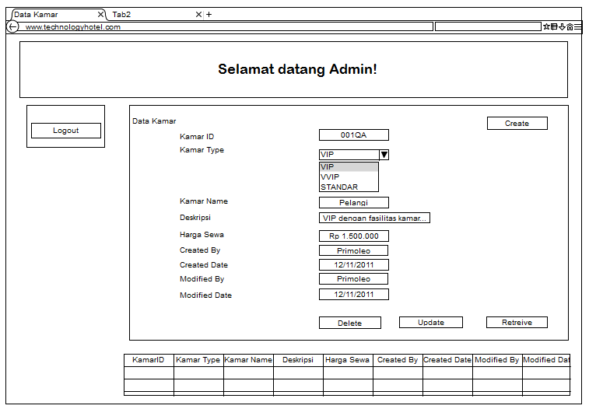
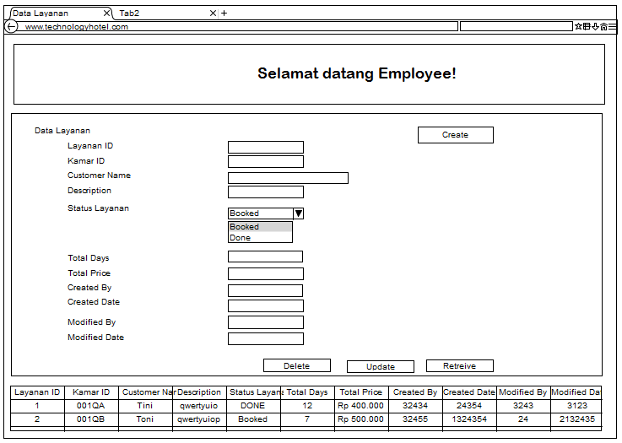
User Interface
13
Dashboard admin
Dashboard employee
Booking Management

Slide 14
See you soon…
Akurat
Cepat
Mudah

